Slide 1
LGPS Pension Managers’ Conference 2020
LGPS Legal Update
- Pension Scams and the Rise of the CMCs
18 November 2020
Gary Delderfield, Partner, Head of Public Sector Pensions
Francois Barker, Partner, Head of UK Pensions

Slide 2
Pensions transfers: an increasing LGPS risk
Scam risk
The rise of case management companies and DSARs
FCA concerns over transfer levels
TPR Focus

Slide 3
TPR: Pledge to combat pension scams
Timely new campaign launched by TPR
Scams risk flagged in TPR’s 2019 LGPS Engagement Report
Industry urged to help protect savers thinking of cashing in their pensions by ensuring they can spot the warning signs and are informed of the risks
Over £30 million has been reportedly lost to pension scammers since 2017
Scammers target pension pots big and small, losses range from under £1,000 to as much as £500,000 per member
While the average victims are men in their fifties, anyone can be a victim
Over recent months we have seen noticeable increase in claims against LGPS Funds relating to historic cases by Claims Management Companies – Money Redress and Claiming 4U and Claimant Litigation Firms - Hugh James and HSS

Slide 4
Pensions transfers question
Has your Fund received any claims relating to historic pension transfers in the past year?

Slide 5
Pensions transfers
What are we looking at today?
1.
The legal framework
2.
The Pensions Ombudsman’s approach
3.
What next?
5.
Rise of the Claims Management Companies
1
2
3

Slide 6
Pensions transfers
The legal framework

Slide 7
Pensions transfers: the legal framework
What are the Administering Authority’s legal duties?
Does the member have a legal right to transfer?
If yes, you must transfer them
If no, discretion to transfer?
Do you have a duty to the member to check/flag scam risks?
Yes (but there are limits)
Do you need to notify the transfer to TPR?
No unlike private sector the notifiable events regime does not apply to LGPS

Slide 8
When does a member have a legislative right to transfer?
Key points to check about the member
Minimum two years of qualifying service
Stopped accruing rights, usually 1 year + pre- ‘normal pension age’
No pension is being paid for those rights
Transferring all rights or all rights of a certain ‘type’
Key points to check about the receiving arrangement
Must be occupational pension scheme (OPS), personal pension scheme, qualified recognised overseas pension scheme (QROPS) or annuity
Must be willing to receive the payment
For UK schemes: check HMRC registration, QROPS: check HMRC list.
Detailed requirements for being, e.g., OPS or QROPS – e.g. for OPS:
‘Founder’ and ‘purpose’ tests
Member must be ‘earner’

Slide 9
Pensions transfers
The Pensions Ombudsman

Slide 10
Hampshire Case [PO 21489]
Mrs H cold called by Pensions Matters Associates in 2013 – not FCA authorised (not then a requirement)
Council sent transfer statement, request form and discharge form as well as TPR’s ‘Scorpion’ warning
Scheme’s employer was Focusplay – a steel stockholder in Warrington set up in 1999
Scheme was an occupational pension scheme registered with HMRC and set up in 2013

Slide 11
Hampshire Case [PO 21489]
Mrs H was not working and lived on South coast on State benefits
Transfer of £26,234 was paid to the Scheme – took 25% as lump sum
2015 Mrs H became concerned about her pension
Contacted CMC who approached the Fund
2017 – Scheme’s trustee was closed down by Insolvency Service
2018 – MD of trustee charged with fraud – over £290,000
Mrs H’s benefits were lost

Slide 12
Hampshire Case [PO 21489]
Overriding consideration for Council is to evaluate transfer application so that a valid statutory transfer right is complied with and an invalid transfer application is legitimately withheld
Council’s argued it could not refuse the statutory right – incorrect!
Mrs H was not an ‘earner’ (in any employment) and so could not acquire ‘transfer credits’ in the new occupational scheme
Therefore she had no statutory right to a transfer – instead Council had a discretion to implement the transfer
Failure to conduct further due diligence was maladministration
Council did not identify the red flags:
member approaching NRA
living on South coast
employer in Warrington
new scheme

Slide 13
Hampshire Case [PO 21489]
Council failed to contact Mrs H
Council should have done more
More likely than not Mrs H would have changed her mind
Council ordered to reinstate revalued benefits (allowing for the lump sum taken)
£500 distress and inconvenience award
If Scheme recovers her benefits Council may recover that amount from Mrs H

Slide 14
Hampshire Case [PO 21489] – Summary
Hampshire specific on its facts
Hinges on fact Mrs H was not an ‘earner’
Highlights complexity of the legislation
Need to understand if statutory right exists or not
Need for due diligence and ‘to do more’
Potential cost to the administering authority of getting it wrong
Good example of a type of scam and ‘red flags’
Also seeing scam transfers to:
SIPPS
SASSs including those set up without member knowledge
QROPS

Slide 15
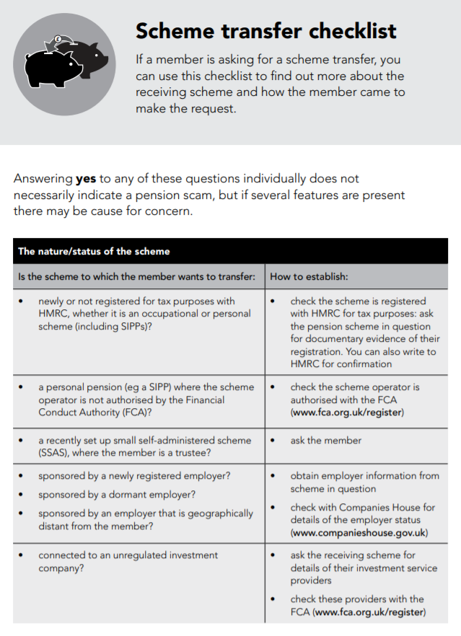
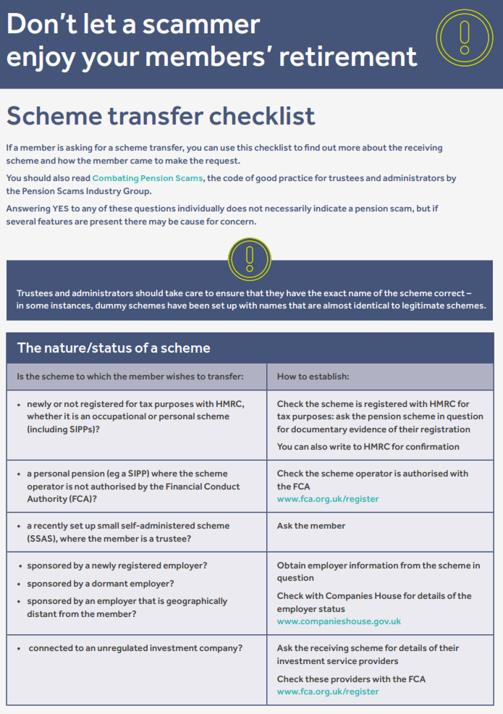
Due diligence: the changing standards
Key guidance
February 2013
July 2014
March 2015
March 2016
c. July 2017
c. January 2019

Slide 16
General themes from the Pensions Ombudsman
Fewer blocked transfer complaints and increase in lack of due diligence cases
PO will consider internal procedures and what was reasonable at the time of the transfer request
PO will consider whether administering authority asked the right questions
But PO will consider the member’s motivation for the transfer

Slide 17
Is complying with the law enough?
The law is not always clear, so for red flags:
always do detailed due diligence
if a legal right to transfer, consider getting advice
The law is changing: Pension Schemes Bill changes
Important to comply and have a clear audit trail to show it
Growing body of best practice guidance, e.g.:
Combatting Pension Scams – A Code of Good Practice
New All Party Parliamentary Group industry resource page
TPR’s scams campaign – option to pledge support

Slide 18
Rise of the Claims Management Companies

Slide 19
Case management companies: what do you need to know?
Large numbers (2018: approx. 3,000 CMCs), increasing pensions focus
Typically start with data subject access requests (DSARS)
How do they get hold of your former members?
FCA focus to eradicate previous poor behaviours of some

Slide 20
CMCs: some practical tips
DSARs: what happens if you receive large numbers?
Check CMC has the necessary authority(ies)
See ICO’s new Code of Practice
Policy / template response letter?
Industry starting to raise this issue with the FCA
In any event:
Keep a log (for reference in any member complaints)
Check what information you need to provide
Member complaints
Administering Authority must consider all relevant factors - CMC existence isn’t one
CMC / member interests not always the same
Can / should you write direct to CMC?
Some tactical suggestions

Slide 21
What next? Can authorities do more to protect themselves and their members?

Slide 22
Pensions transfers question Part 1
Does your Fund currently recommend a pre-selected panel of IFAs to members considering transfers out?

Slide 23
What next?
Private sector moves to appoint IFAs to support members:
Scheme appoints IFA and makes available
Member contracts with IFA directly
Why do this?
Right thing to do for members – means better quality, more cost-effective advice
Concerns about broadening authority’s duty of care … But British Steel shows there is no risk free option
No single right answer – key is to take an informed decision.

Slide 24
What next? What to look for with IFA panels
Staying the right side of the FCA regulated activity
Avoiding unauthorised payments
Initial IFA due diligence
Ongoing IFA monitoring
Contracts
Member communications
Consider an IFA panel

Slide 25
What next? Conclusions
Members: increasingly need good quality, cost-effective financial advice – IFA panels deliver this
Authorities: Doing nothing doesn’t automatically lower the risk: weigh the risks and take a decision
Features: Good governance around the panel will protect authorities from exposure

Slide 26
Pensions transfers question Part 2
In light of this session, is the use of a pre-selected panel of IFAs something you think may be worth considering?

Slide 27
Action points / take-aways
IFA panel?
Further training?
Transfer processes: audit?
Keep an eye on developments:
CMC regulation
Pension Schemes Bill
FCA’s upcoming guidance
Work and Pensions Committee enquiry
TPR scams campaign
CMC prep:
Policy?
Log?
Standard letters?
LGPS-wide co-ordination

Slide 29
Questions?

